Slide 1



PROGRAMMING 1
INTRO TO PROG (C#)
Cagayan State University
Aparri Campus

Slide 2


Programming
Programming is the creation of an ordered set of instructions to solve a problem with a computer. The instructions sometimes referred to as codes make up a computer program.

Slide 3
Programming
Process
The programming process is a step-by-step approach used to design, develop, test, and maintain a computer program. It ensures that the software meets its purpose, works correctly, and is easy to update or improve.

Slide 4
Steps in the Programming Process

Slide 5
Understand the Problem
Plan the Solution (Algorithm Design)
Before writing any code, you must clearly understand what needs to be done.
  What is the program supposed to do?
  What inputs will it need?
  What outputs are expected?
Example: Create a program that calculates the average of 3 test scores.
Decide how the program will solve the problem. This involves:
  Writing an algorithm – a set of step-by-step instructions.
  Drawing flowcharts or writing pseudocode.
Example: Think of it as creating a blueprint before building a house.

Slide 6
Write the Code
Test the Program
Now translate your plan into a real programming language
  Use correct syntax
  Follow coding standards and best practices
Run the program with different sets of input to make sure it:
  Produces correct results
  Handles errors properly
  Doesn’t crash or behave unexpectedly
📌 Try normal, edge, and incorrect inputs.

Slide 7
Debug and Fix Errors
Deploy the Program
Now translate your plan into a real programming language
  Use correct syntax
  Follow coding standards and best practices
Once everything works, you can release or use the program. This might involve:
  Installing it on a computer or server
  Sharing it with users or clients
Maintain and Update
After release, the program might need:
  Updates to fix new bugs
  Improvements or new features
  Changes to adapt to user needs

Slide 8
Why follow the programming process?
  Saves time and reduces errors
  Helps you stay organized and focused
  Makes your code easier to read and maintain
  Ensures the program meets its goals

Slide 9
Formulating
Algorithms
What is an Algorithm?
An algorithm is a step-by-step set of instructions used to solve a specific problem or perform a task.
In programming, algorithms are the foundation of how computers solve problems.

Slide 10
Why Formulate Algorithms?
Before writing any code, it's important to think through the logic of your solution.

Slide 11
Steps in Formulating an Algorithm
Debug and Fix Errors
Identify the Steps Needed
Ask:
  What are the inputs?
  What is the expected output?
  What are the rules or limitations?
📌 Example: "Find the largest of three numbers"
Break the problem into logical, manageable steps. Think about what the program must do in order.

Slide 12
Write the Steps in a Clear Sequence
Example Algorithm (Plain English)
You can express the algorithm in:
  Plain English (natural language)
  Pseudocode – a code-like description
  Flowchart – diagram of the steps
Good algorithms are:
  Unambiguous – clear and not open to interpretation
  Finite – they end after a set of steps
  Effective – each step does something useful
Problem: Find the sum of two numbers.
Algorithm:
  Start
  Input number1
  Input number2
  Add number1 and number2, store result in sum
  Display sum
  End

Slide 13
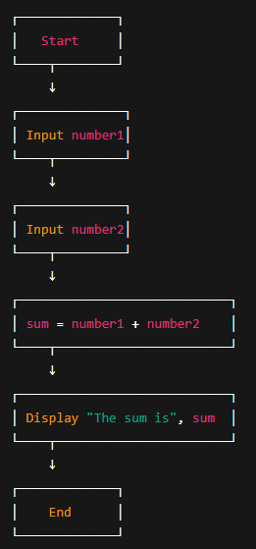
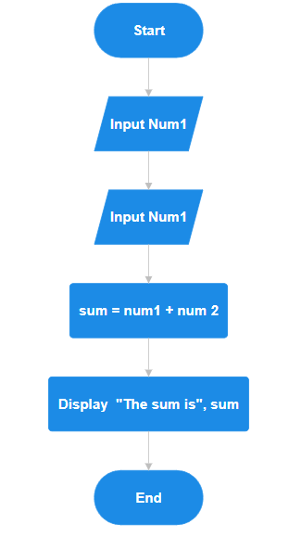
Sample:
Plain English Text
  Start the program.
  Ask the user to enter the first number.
  Ask the user to enter the second number.
  Add the two numbers and store the result in a variable called sum.
  Show the sum to the user.
  End the program.
PseudoCode
BEGIN
PROMPT "Enter first number"
READ number1
PROMPT "Enter second number"
READ number2
sum ← number1 + number2
DISPLAY "The sum is", sum
END
Flowchart (Diagram of the Steps)

Slide 14
Common Data Types
Primitive Data Types that can only store a single value each

Slide 15
start
Sumakay sa sasakyan
Travel from point a to point b
Bababa sa sasakyan
end

Slide 16
1. String
  Reference Type
  Sequence of characters
2. Integer
  Value Type
  Whole numbers
3. Float
  Value Type
  With Decimal numbers

Slide 17
4. Double
  Value Type
  More precise than float
5. Boolean
7. Var
  Value Type
  True or False
  Value Type
  Compiler decides type
6. Char
  Value Type
  Single character

Slide 18
Constants
Constants values cannot be change during runtime but not all Data Types cannot be constant
“const”
  const int MAX_AGE = 100;
  const string GREETING = "Hello!";

Slide 19
Operators
This operators can be use to perform arithmetic sequence and computations

Slide 20
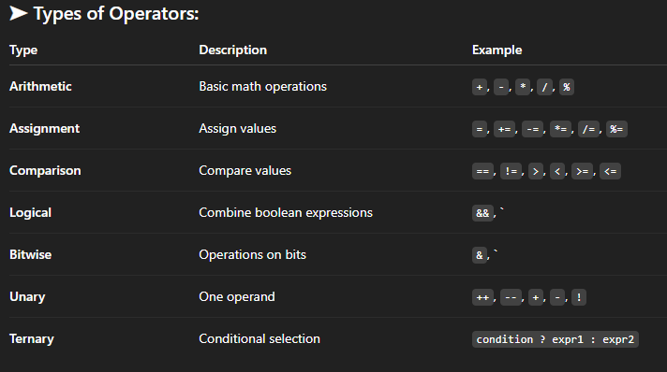

Slide 21
Expressions
An expression is a combination of variables, operators, constants, and method calls that is evaluated to produce a value.

Slide 22
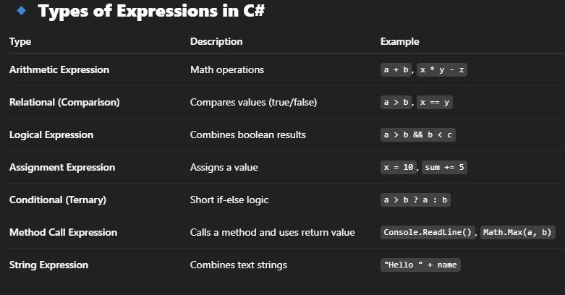

Slide 23

Major parts
of a
program
A computer program is made up of different parts that work together to perform a task. Understanding these parts helps you write correct and organized code.

Slide 24
1. Documentation / Comments
  Purpose: Explain what the program does.
  Not executed by the computer—just for the programmer.
In C#: // This program adds two numbers
2. Preprocessor Directives / Using Statements
  Purpose: Import libraries or namespaces that give you access to built-in features.
In C#: using System;
3. Namespace Declaration
  Purpose: Groups related code together and avoids name conflicts.
In C#: namespace MyProgram
{
// Classes go here
}

Slide 25
4. Class Definition
  Purpose: All code in C# must be inside a class. A class is like a blueprint for your program.
In C#: class Program
{
// Methods go here
}
5. Main Method
  Purpose: This is the starting point of every C# program. The computer begins execution here.
In C#: static void Main(string[] args)
{
// Program logic starts here
}

Slide 26
6. Statements and Expressions (Body of the Program)
  A statement is a complete instruction that performs an action. It's usually followed by a semicolon ;
In C#: int number1 = 10;
int number2 = 20;
int sum = number1 + number2;
Console.WriteLine("The sum of " + number1 + " and " + number2 + " is " + sum);
Console.ReadLine(); // Wait for the user to press Enter before closing

Slide 27
// Import the System namespace to use built-in classes like Console
using System;
// Declare a namespace to logically group related code
namespace SampleProgram
{
// Define a class - the building block of C# programs
class Program
{
// Main method - the entry point of the program
static void Main(string[] args)
{
// Declare variables to hold numbers
int number1 = 10; // First number
int number2 = 20; // Second number
// Calculate the sum (this is an expression)
int sum = number1 + number2;
// Output the result (this is a statement)
Console.WriteLine("The sum of " + number1 + " and " + number2 + " is " + sum);
// Pause the program (optional)
Console.ReadLine(); // Wait for the user to press Enter before closing
}
}
}

Slide 28
In Advance Programs
Part | Purpose | Purpose
Methods/Functions | Reusable code blocks that do specific tasks | Reusable code blocks that do specific tasks
Varaibles | Store data used by the program | Store data used by the program
Control Structure | Manage decision-making and repetition | Manage decision-making and repetition
Error handling | Make your program handle unexpected events without crashing | Make your program handle unexpected events without crashing

Slide 29
What is Input and Output?

Slide 30
What is Input and Output?
  Input: Getting data from the user or another source.
  Output: Showing information to the user or sending it somewhere.

Slide 31
1. Output – Console.WriteLine() and Console.Write()
  Console.WriteLine() prints a line and moves to the next line.
  Console.Write() prints a line without moving to the next line
Sample:
  Console.WriteLine("Hello, World!");
  Console.Write("Enter your name: ");
Output:
Hello, World!
Enter your name:

Slide 32
2. Input – Console.ReadLine()
  Used to get input from the user as a string. You can then convert it to other types if needed.
Sample:
Console.Write("Enter your name: ");
string name = Console.ReadLine();
Console.WriteLine("Hello, " + name + "!");
Output:
Enter your name: Jayson
Hello, Jayson!

Slide 33
2. Converting Input to Numbers
Since Console.ReadLine() returns a string, you need to convert it for mathematical use:
  int.Parse() – for whole numbers
  double.Parse() – for decimals
  Convert.ToInt32() – another way to convert to integers
Sample:
Console.Write("Enter your age: ");
int age = int.Parse(Console.ReadLine());
Console.WriteLine("You are " + age + " years old.");

Slide 34
Common Mistakes to Avoid
Mistakes | Why It Happens | How to Fix
Not converting input | Console.ReadLine() gives string | Use int.Parse() or Convert.ToInt32()
Forgetting semicolon | Syntax Error | Always end statements with ;
Incorrect variable type | Mismatch between input and data type | Use correct type conversion

Slide 35
Mini Activity: 1 minute
TODO:
Asks for your first name and age
Output:
"Hello John! You are 20 years old."

Slide 36
Program
Control Structures
Control structures are programming instructions that determine how and when certain blocks of code are executed. They allow programs to:
  Make decisions
  Repeat actions
  Control the flow of execution

Slide 37
1. Sequential Control Structure
  Default behavior: Code runs line by line, from top to bottom.
  No branching or repetition.
Console.WriteLine("Step 1");
Console.WriteLine("Step 2");
Console.WriteLine("Step 3");

Slide 38
2. Selection (Decision-Making) Structure
  Executes code based on a condition.
  C# uses if, else if, else, and switch.
int grade = 85;
if (grade >= 75)
{
Console.WriteLine("You passed!");
}
else
{
Console.WriteLine("You failed.");
}

Slide 39
3. Repetition (Looping) Structure
  Repeats code as long as a condition is true.
  Types in C#: while, for, do-while, and foreach.
for (int i = 1; i <= 5; i++)
{
Console.WriteLine("This is loop #" + i);
}

Slide 40
Looping
Constructs
Looping in C# is a fundamental programming concept used to execute a block of code repeatedly based on a condition. It helps reduce redundancy and automates repetitive tasks in a program. C# provides several types of loops, each suited for different situations:

Slide 41
Types of Loops:
  For Loop:
Used when the number of iterations is known.
for (int i = 1; i <= 5; i++)
{
Console.WriteLine("Iteration: " + i);
}
  While Loop:
Used when the number of iterations is not known, and depends on a condition.
int i = 1;
while (i <= 5)
{
Console.WriteLine("Count: " + i);
i++;
}

Slide 42
Types of Loops:
  do While:
Same as while, but guarantees the loop runs at least once.
int i = 1;
do
{
Console.WriteLine("Count: " + i);
i++;
} while (i <= 5);
  foreach:
Used to loop through elements in a collection (like an array or list).
string[] colors = { "Red", "Green", "Blue" };
foreach (string color in colors)
{
Console.WriteLine(color);
}

Slide 43
Loop Control Statement
  break: exits the loop.
  continue: skips the current iteration and moves to the next.
for (int i = 1; i <= 5; i++)
{
if (i == 3)
continue; // skip when i is 3
Console.WriteLine(i);
}

Slide 44
Best use of Loops
  for Loop
  do while
Best for situations where the number of iterations is known. It includes an initializer, a condition, and an increment/decrement expression all in one line.
Similar to the while loop but ensures the code runs at least once, even if the condition is false at the start.
  while
  foreach
Ideal when the number of repetitions is unknown, and the loop should continue as long as a certain condition is true.
Designed to iterate over collections like arrays, lists, or other enumerable data types, making it useful for accessing each element without manual indexing.

Slide 45
Data-Driven Decision Making
Data-Driven Decision Making is the process of making choices or solving problems based on actual data rather than intuition, guesswork, or personal experience. It involves collecting relevant data, analyzing it using statistical and computational tools, and using the insights gained to guide actions, strategies, or policies.
In this approach, decisions are backed by facts, trends, and patterns found in data, ensuring they are objective, consistent, and measurable. It is widely used in business, healthcare, education, technology, and many other fields to improve outcomes and performance.

Slide 46
  Identify the problem or goal
  Collect and organize relevant data
  Analyze the data using tools like Excel, SQL, Power BI, or Python
  Interpret the results to find patterns, insights, or anomalies
  Make informed decisions based on the findings
  Monitor and evaluate the results of those decisions
Key Steps in DDDM

Slide 47
Benefits of DDDM
  Improves accuracy and efficiency
  Reduces risk and uncertainty
  Encourages accountability
  Supports continuous improvement

Slide 48
THANK YOU
Cagayan State University
Aparri Campus
Jayson M. Cartagena

